Slide 1
Lecture 11
Math Foundations Team

Slide 2
Introduction
We will take a deeper look at some challenges in non-linear optimization, continuing on from the previous lecture.
First we will look at the problem of different levels of curvature in different directions.
We will need to figure out strategies to deal with the above situations to design a good optimization algorithm.
Second we will look into how to solve constrained optimization problem.

Slide 3
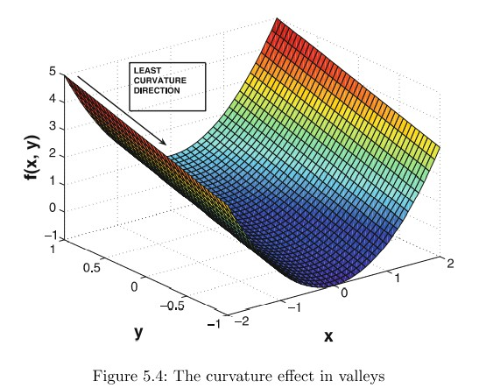
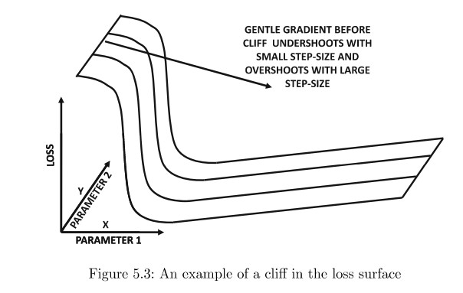
Examples of high curvature surfaces
Two examples of high curvature surfaces are cliffs and valleys.
(a)
(b)

Slide 4
Difficult topologies
In Figure (a), the partial derivative with respect to x changes drastically as we go along the axis of x .
A modest learning rate will cause minimal reduction in the value of the objective function in the gently sloping regions.
The same modest learning rate in the high-sloping regions will cause us to overshoot the optimal value in those regions.
In Figure (b), there is gentle slope along the y -direction and a U-shape in the x -direction.
The gradient descent method will bounce violently along the steep sides of the valley while not making much progress along the x -axis.

Slide 5
Gradient descent with momentum
Gradient descent may be slow if the curvature of the function is such that the gradient descent steps hop between the walls of the valley of contours and approaches the optimum slowly.
If we endow the optimization procedure with memory, we can improve convergence.
We use an additional term in the step-update to remember what happened in the previous iteration, so that we can dampen oscillations and speed up convergence.
This is a momentum term - the name momentum comes from a comparison to a rolling ball whose direction becomes more and more difficult to change as its velocity increases.

Slide 6
Gradient descent with momentum
The gradient descent with momentum has the following iteration
x_{i +1} = x_{i} − α_{i} ((∇f )(x_{i} ))^{T} + v_{i}
v_{i} = β(x_{i} − x_{i −1}) and v₀ = 0
β ∈ [0, 1] is referred to as the momentum parameter or the friction parameter.
Momentum-based methods attack the issues of flat-regions, cliffs and valleys by emphasizing medium-term to long-term directions of consistent movement.

Slide 7
Momentum-based learning
An aggregated measure of feedback is used to reinforce movement along certain directions and speed up gradient descent.
Momentum-based learning accelerates gradient descent since the algorithm moves quicker in the direction of the optimal solution.
The useless sideways oscillations as they get cancelled out during the averaging process.
The momentum term is useful where only approximate gradient is known as the momentum term averages out the noisy estimates of the gradient.

Slide 8
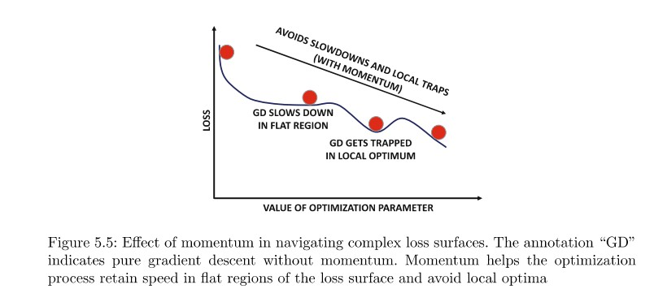
Momentum-based learning
The concept of momentum can be illustrated by a marble rolling down a hill that has a number of ”local” distortions like potholes, ditches etc. The momentum of the marble causes it to navigate local distortions and emerge out of them.

Slide 9
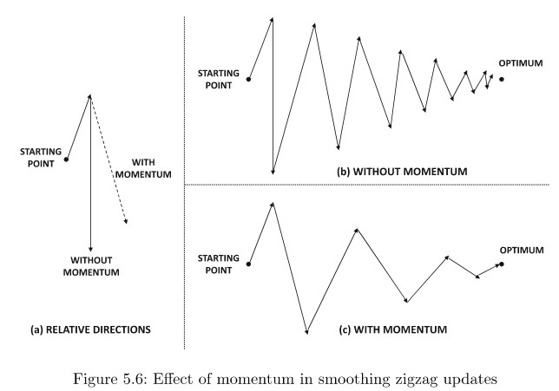
Momentum-based learning
Momentum increases the relative component of the gradient in the correct direction

Slide 10
Example: Gradient Descent with initial value 0.5 and Learning parameter 0.1 (30 iterations)
Iteration 0: x = 0.500000
Iteration 1: x = 0.400000
Iteration 2: x = 0.320000
Iteration 3: x = 0.256000
Iteration 4: x = 0.204800
Iteration 5: x = 0.163840
Iteration 6: x = 0.131072
Iteration 7: x = 0.104858
Iteration 8: x = 0.083886
Iteration 9: x = 0.067109
Iteration 10: x = 0.053687

Slide 11
Example Gradient Descent with Momentum with Initial value 0.5, Learning parameter 0.1 and Momentum parameter 0.2 (30 iterations)
0.400000
0.320000
0.256000
0.204800
0.163840
0.131072
0.104857
0.083886
0.067109
0.053687
0.042949
0.034359
0.027487
0.021989
0.017591
0.014073
0.011258
0.008983
0.007186
0.005749
0.004599
0.003679
0.002943
0.002355
0.001884
0.001508
0.001206
0.000965
0.000772
0.000617

Slide 13
AdaGrad
If the gradient takes values +100 and -100 alternatively, A_{i} will be large and the update step along the parameter in question will be small.
If the gradient takes a value 0.1 consistently, A_{i} will not be as large as before and the update step will be comparatively larger.
With the passage of time absolute movements along all components will slow down because A_{i} is monotonically increasing with time.
AdaGrad suffers from the problem of not making much progress after a while. The fact that A_{i} is aggregated over the entire history of partial derivatives may make the method stale.

Slide 14
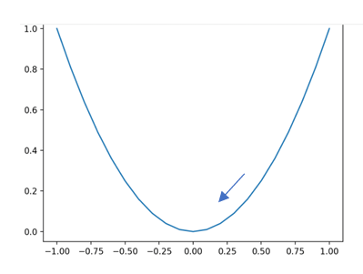
Example
In this example we compare the speed of convergence among the three methods Gradient Descent, Gradient Descent with momentum.
We take the curve y = x² which is drawn as follows:
Obviously (0, 0) is the Global minimum.

Slide 15
Gradient Descent with Momentum Versus AdaGrad
Situation | Momentum Based | AdaGrad
To deal with non-stationary objectives or deep Learning | Yes (Momentum helps accelerate convergence in relevant directions and smooth out oscillations) | No
Sparse Data | No | Yes (AdaGrad adapts learning rates per parameter, giving larger updates to infrequent features and smaller updates to frequent ones.)

Slide 16
Gradient Descent with Momentum Versus AdaGrad
Situation | Momentum Based | AdaGrad
Long Term Learning | Yes | No (Too aggressive decay)
The gradients vary significantly across parameters | No | Yes(AdaGrad’s per-parameter learning rate is helpful if some parameters receive very small or very large gradients.)
Convex or Simple Objective | No | Yes (For convex problems or shallow networks, AdaGrad often converges quickly and efficiently.)

Slide 19
Adam
Adam incorporates momentum into the update.
Adam addresses the initialization bias present in RMSProp. Both F_{i} and A_{i} are initialized to zero which causes bias in early iterations.
The two quantities are affected differently which accounts for the equation for α_{t} .
►
t t
As t → ∞, ρ → 0, ρ → 0 and α → α since ρ, ρ ∈ (0, 1).
f
t f
The default suggested value for ρ_{f} and ρ are 0.9 and 0.999 respectively.

Slide 20
Constrained optimization and Lagrange multipliers
Consider the following problem: min f (x), f : R^{D} → R,
x
subject to additional constraints - so we are looking at a minimization problem except that the set of all x over which minimization is performed is not all of R^{D} .
The constrained problem becomes min_{x} f (x)
subject to g_{i} (x) ≤ 0 ∀i 1, 2, . . . m.
If we convert constrained optimization problem into an unconstrained one, we can use techniques we studied
►
We construct J(x) = f (x) +
Σ
i =m i =1
1(g (x)), where 1(z ) = 0
i
for z ≤ 0 and 1(z ) = ∞ for z > 0.

Slide 21
Constrained optimization and Lagrange multipliers
The formulation of J(x) in the previous slide ensures that the optimal solution to the unconstrained problem is the same as the constrained problem.
The step-function is also difficult to optimize. Hence, we replace the step-function by a linear function using Lagrange multipliers.
We create the Lagrangian of the given constrained
optimization problem as follows:
L(x , λ) = f (x) +
λ_{i} ≥ 0 for all i .
Σ
i =m
T
λ g (x) = f (x) + λ g(x), where
i =1
i i

Slide 22
Primal and dual problems
The primal problem is min f (x) subject to
g_{i} (x) ≤ 0, 1 ≤ i ≤ m. Optimization is performed over the primal variables x.
The associated Lagrangian dual problem is max_{λ∈R}m D(λ) subject to λ ≥ 0 where λ are dual variables.
D(λ) = min d L(x , λ).
x ∈R
The following minimax inequality holds over two arguments
x , y: max_{y} min_{x} ϕ(x , y) ≤ min_{x} max_{y} ϕ(x , y).

Slide 23
Minimax inequality
Why is this inequality true?
Assume that x , y: max_{y} min_{x} ϕ(x , y) = ϕ(x_{A}, y_{A}) and min_{x} max_{y} ϕ(x , y) = ϕ(x_{B}, y_{B} ).
Fixing y at y_{A} we see that the inner operation on the left hand side of the minimax inequality is a min operation over x and returns x_{A}. Thus we have ϕ(x_{A}, y_{A}) ≤ ϕ(x_{B}, y_{A}).
Fixing x at x_{B} we see that the inner operation on the right hand side of the minimax inequality is a max operation over y and returns y_{B} . Thus we have ϕ(x_{B}, y_{B} ) ≥ ϕ(x_{B}, y_{A}).
From the above we conclude that ϕ(x_{B}, y_{B} ) ≥ ϕ(x_{A}, y_{A}).

Slide 24
Minimax inequality
The difference between J(x) and the Lagrangian L(x , λ) is that the indicator function is relaxed to a linear function.
When λ ≥ 0, the Lagrangian L(x , λ) is a lower bound on
J(x).
The maximum of L(x , λ) with respect to λ is J(x) - if the point x satisfies all the constraints g_{i} (x) ≤ 0, then the maximum of the Lagrangian is obtained at λ = 0 and it is equal to J(x).
If one or more constraints is violated such that g_{i} (x) > 0, then the associated Lagrangian coefficient λ_{i} can be taken to be ∞ so as to equal J(x).

Slide 25
Minimax inequality
From the previous slide, we have J(x) = max_{λ≥0} L(x , λ).
Our original constrained optimization problem boiled down to minimizing J(x), in other words we are looking at
min d max_{λ≥0} L(x , λ)
x ∈R
Using the minimax inequality we see that
min_{x ∈R}d max_{λ≥0} L(x , λ) ≥ max_{λ≥0} min_{x ∈R}d L(x , λ).
This is known as weak duality. The inner part of the right hand side of the inequality is D(λ).

Slide 26
Lagrangian formulation
In contrast to the original formulation
D(λ) = min_{x ∈R}d L(x , λ) is an unconstrained optimization problem for a given value of λ.
We observe that D(λ) = min d L(x , λ) is a point-wise
x ∈R
minimum of affine functions and hence D(λ) is concave even
though f () and g () may be nonconvex.
We have obtained a Lagrangian formulation for a constrained optimization problem where the constraints are inequalities. What happens when some constraints are equalities?

Slide 27
Modeling equality constraints
Suppose the problem is min_{x} f (x) subject to g_{i} (x) ≤ 0 for all 1 ≤ i ≤ m and h_{j} (x) = 0 for 1 ≤ j ≤ n.
We model the equality constraint h_{j} (x) = 0 with two inequality constraints h_{j} (x) ≥ 0 and h_{j} (x) ≤ 0.
The resulting Lagrange multipliers are then unconstrained.
The Lagrange multipliers for the original inequality constraints are non-negative while those corresponding to the equality constraints are unconstrained.

Slide 28
Convex optimization
We are interested in a class of optimization problems where we can guarantee global optimality.
When f (), the objective function, is a convex function and g () and h() are convex functions, we have a convex optimization problem.
In this setting we have strong duality - the optimal solution of the primal problem is equal to the optimal solution of the dual problem.
What is a convex function?

Slide 29
Convex function
First we need to know what is a convex set. A set C is a convex set if for any x, y ∈ C , θx + (1 − θ)y ∈ C .
For any two points lying in the convex set, a line joining them lies entirely in the convex set.
Let a function f : R^{d} → R be a function whose domain is a convex set C .
The function is a convex function if for any x , y ∈ C ,
f (θx + (1 − θ)y) ≤ θf (x) + (1 − θ)f (y)
Another way of looking at a convex function is to use the gradient: for any two points x and y, we have
f (y) ≥ f (x) + ∇_{x} f (x)(y − x).

Slide 30
Example
The negative entropy, a useful function in Machine Learning, is convex: f (x ) = xlog₂x for x > 0.
First let us check if f (θx + (1 − θ)y ) ≤ θf (x ) + (1 − θ)f (y ).
Take x = 2, y = 4, and θ = 0.5 to get
f (0.5 ∗ 2 + 0.5 ∗ 4) = f (3) = 3log₂3 ≈ 4.75. Then
θf (2) + (1 − θ)f (4) = 0.5 ∗ 2log₂2 + 0.5 ∗ 4log₂4 = log₂32 = 5.
Therefore the convexity criterion is satisfied for these two points.
Let us now use the gradient criterion. We have
1
∇_{x} f (x) = log₂x + x _{xloge 2} .
f (2) + ∇f (2) ∗ (4 − 2) = 2log 2 + (log 2 +
1
∗ 2 ≈ 6.9.
2 2
loge 2
We see that f (4) = 4log₂4 = 8 which shows that the gradient criterion is also satisfied.

Slide 31
Linear programming
Let us look at a convex optimization problem where the objective function and constraints are all linear.
Such a convex optimization problem is called a linear programming problem.
T
We can express a linear programming problem as min_{x} c x
subject to Ax ≤ b where A ∈ R^{m×d} and b ∈ R^{m×1}.
The Lagrangian L(x , λ) is given by
L(x , λ) = c^{T} x + λ^{T} (Ax − b) where λ ∈ R^{m} is the vector of non-negative Lagrangian multipliers.
We can rewrite the Lagrangian as
L(x , λ) = (c + A^{T} λ)^{T} x − λ^{T} b.

Slide 32
Linear programming
Taking the derivative of the Lagrangian with respect to x and setting it to zero we get c + A^{T} λ = 0.
Since D(λ) = min d L(x , λ), plugging in the above
x ∈R
We would like to maximize D(λ), subject to the constraint
equation gives D(λ) = −λ^{T} b.
λ ≥ 0.
Thus we end up with the following problem:
T
max_{λ∈R}m − λ b
subject to c + A^{T} λ = 0
λ ≥ 0

Slide 33
Linear programming
We can solve the original primal linear program or the dual one - the optimum in each case is the same.
The primal linear program is in d variables but the dual is in m variables, where m is the number of constraints in the original primal program.
We choose to solve the primal or dual based on which of m or
d is smaller.

Slide 34
Quadratic programming
We now consider the case of a quadratic objective function subject to affine constraints:
1
min x ^{T} Qx + c ^{T} x subject to
x ∈R^{d} ₂
Ax ≤ b
Here A ∈ R^{m×d} , b ∈ R^{m}, c ∈ R^{d}

Slide 35
Quadratic programming
The Lagrangian L(x , λ) is given by
1 T T
T
x Qx + c x + λ (Ax − b).
2
Rearranging the above we have
1 T T T T
L(x , λ) = x Qx + (c + A λ) x − λ b
2
Taking the derivative of L(x , λ) and setting it equal to zero gives Qx + (c + A^{T} λ) = 0.
If we take Q to be invertible, we have x = −Q⁻¹(c + A^{T} λ).
Plugging this value of x into L(x , λ) gives us
1 T −1 T T
D(λ) = − (c + A λ)Q (c + A λ) − λ b.
2
This gives us the dual optimization problem:
1 T −1 T T
max m − (c + A λ)Q (c + A λ) − λ b subject to
λ∈R
2
λ ≥ 0.

